Slide 1
LOVE_DEATH_ROBOTS
Armon, Eric, Omar

Slide 2
Overview
Based off an IMU code and created a tracking system based off GPS coordinates that will pull live updates from the object it is tracking

Slide 3
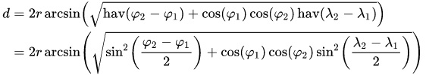
Haversine
A mathematical function used to find the heading between two GPS coordinates
Initialization of destination for the initial and final coordinates
Calculated the distance between 2 coordinates
Calculate the radius and distance traveled

Slide 4
Haversine Continued
Destination function
Setting latitude and longitude variables
Calculates the heading between two GPS coordinates
Converting GPS coordinates to directional headings
Returns compass heading and directional angle

Slide 5
Motor control
The motors are controlled from While loops based on the data produced from Haversine
A Raspberry Pi pulses a selected set of pins to generate motor movement.
Robot Operating System (ROS) delivers GPS coordinate
There are 3 threads, IMU, GNNS (Global Navigation Satellite System) and the motor controls

Slide 6
ROSbridge
ROSbridge allows communication to other devices running ROS and can pull values posted on the other device
Does this through a websocket

Slide 7
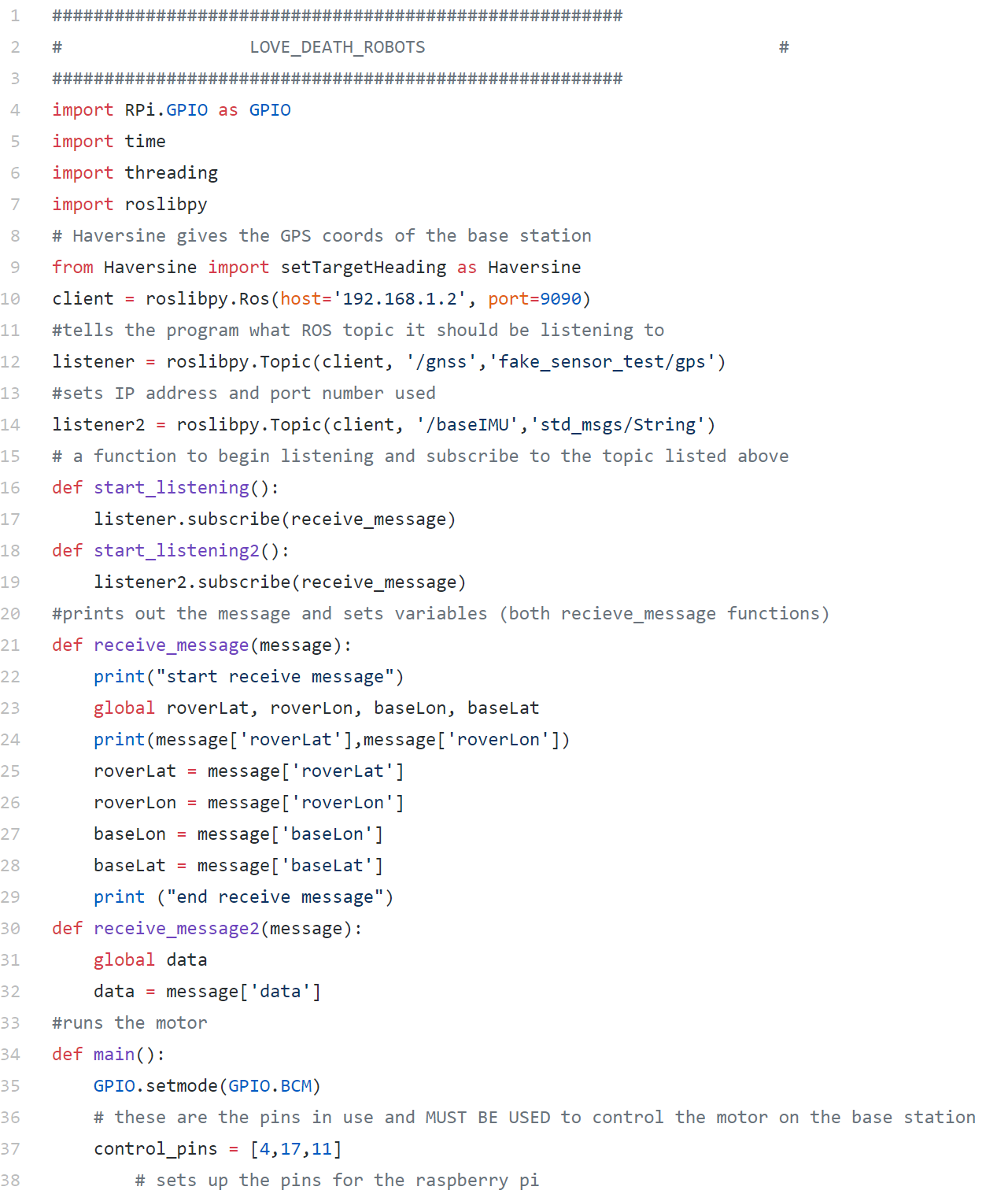
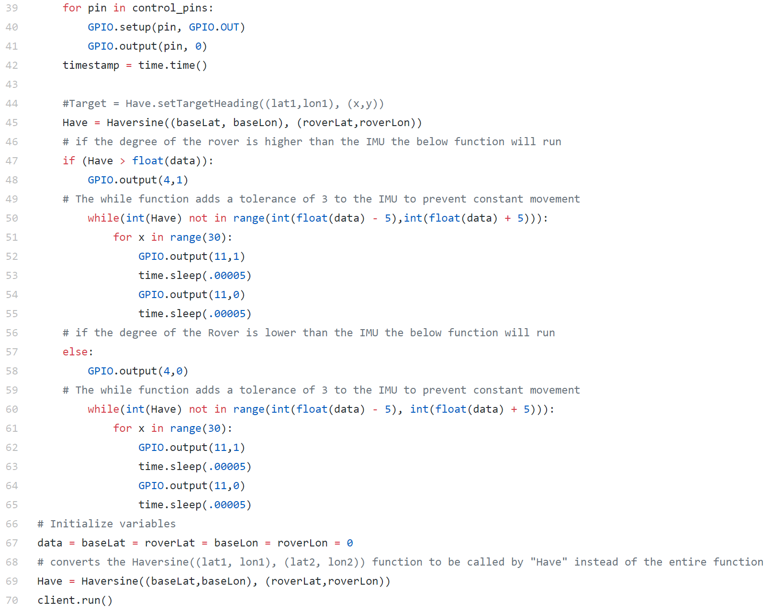
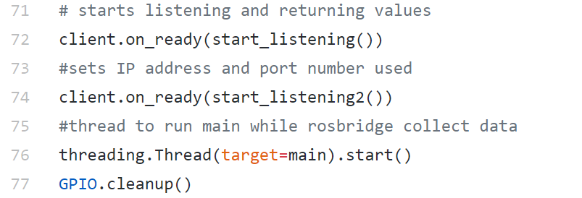
Motor control and rosbridge

Slide 8
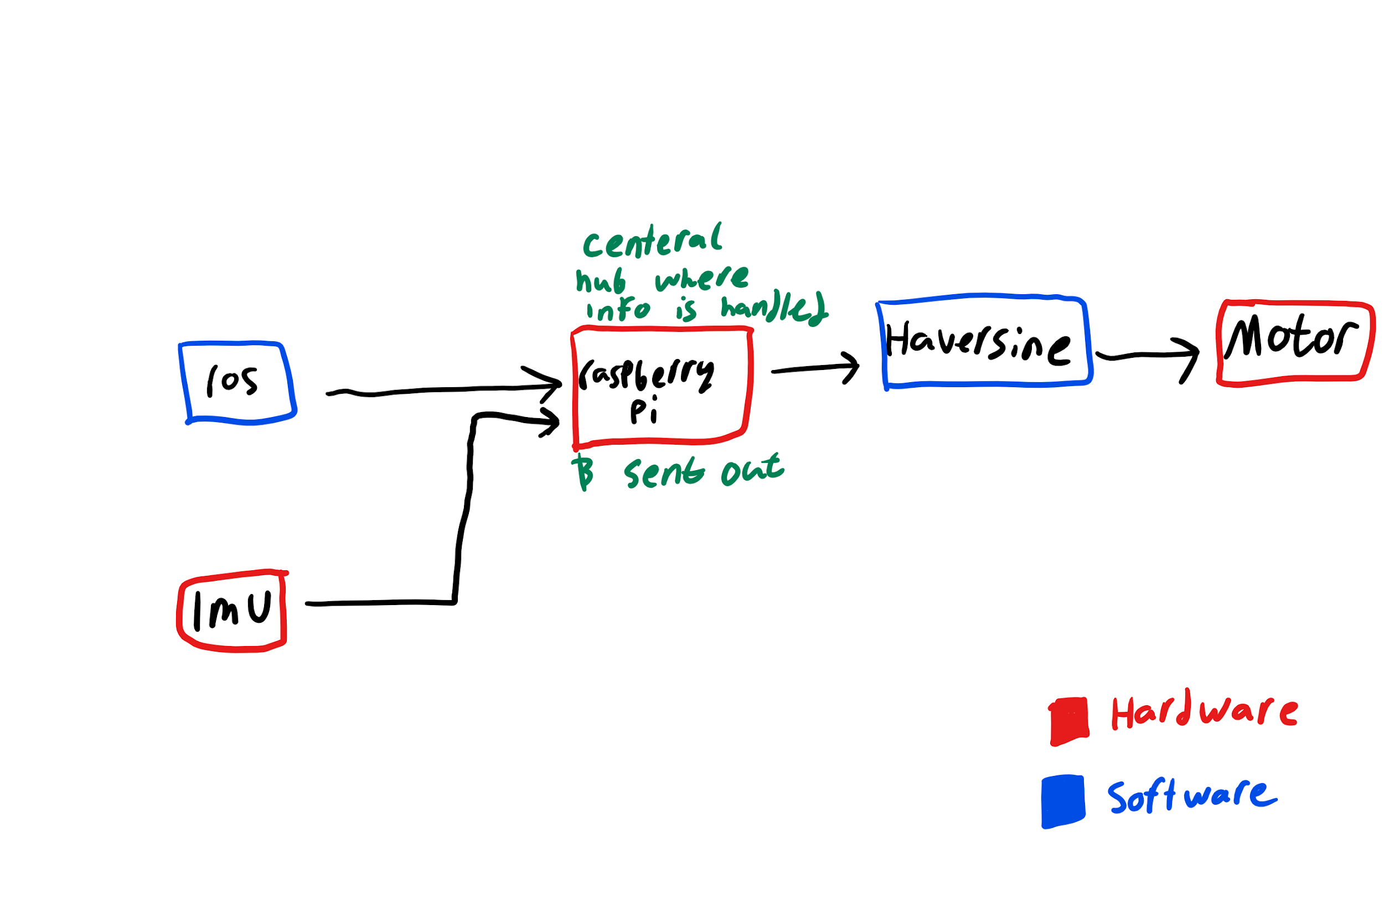
Flowchart

Slide 9
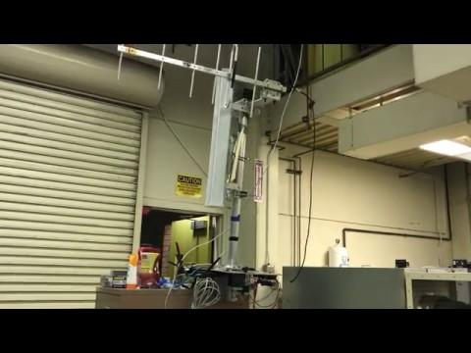
Final product

Slide 10

Final product part 2

